Slide 1
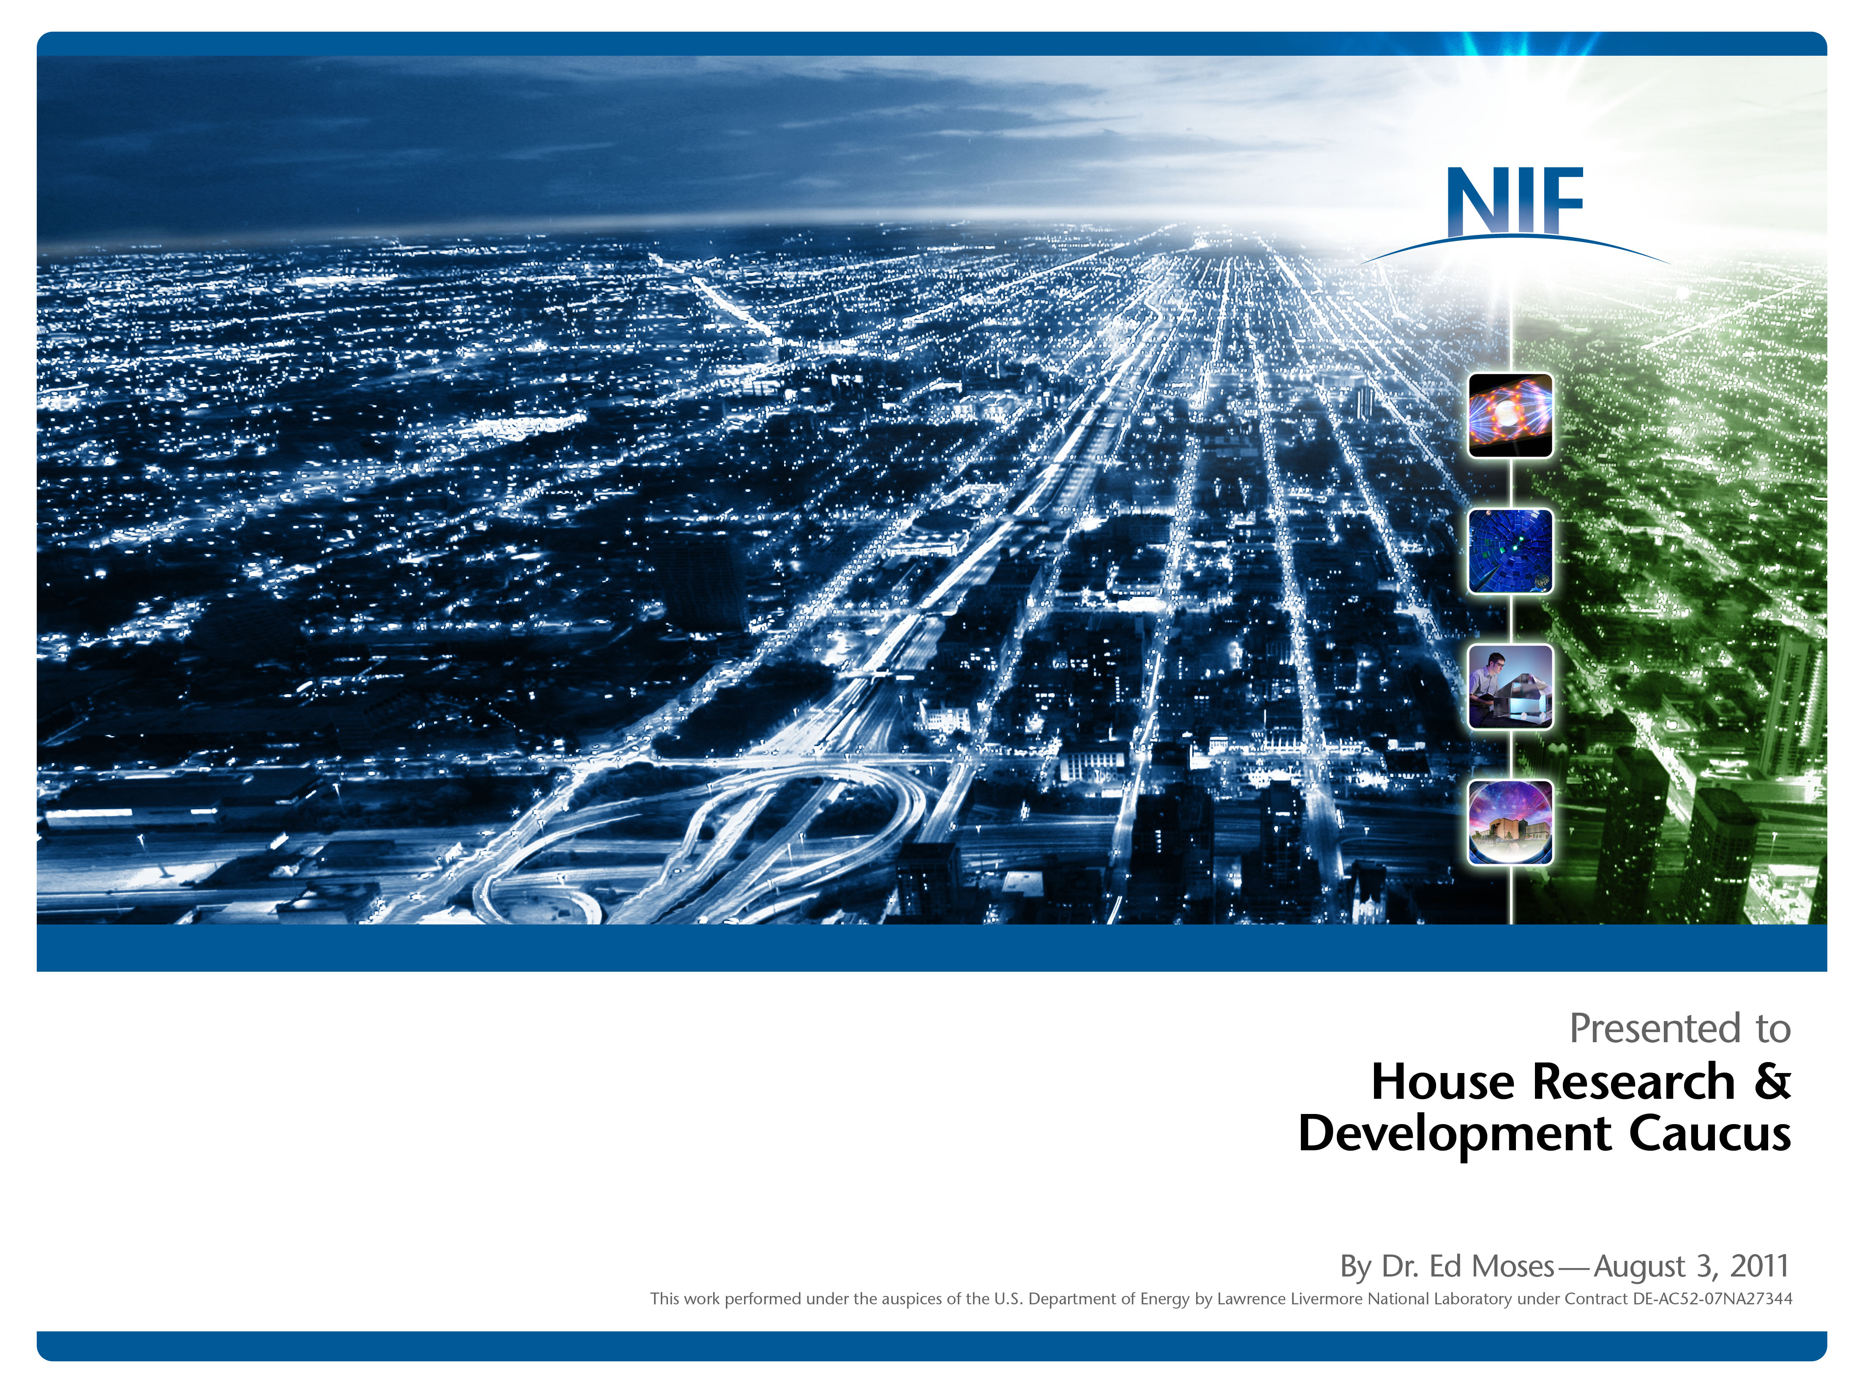
House Research and Development Caucus, August 3, 2011

Slide 2
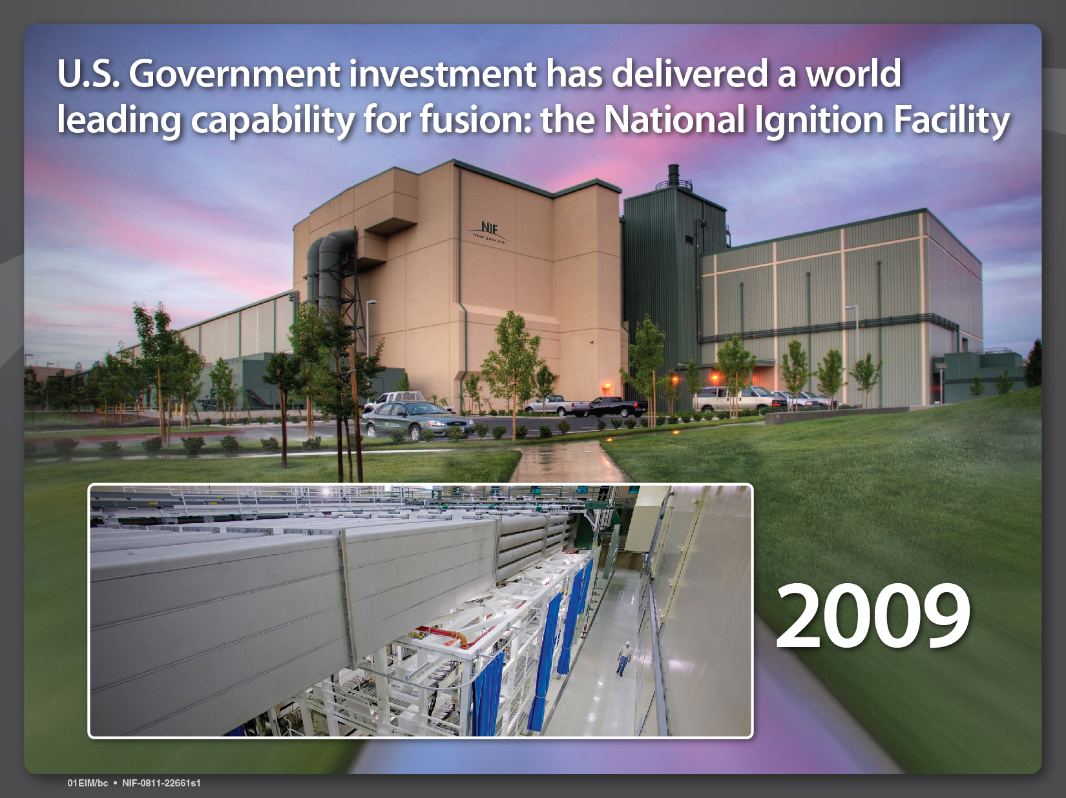
U.S. Government investment has delivered a world leading capability for fusion: the National Ignition Facility

Slide 3
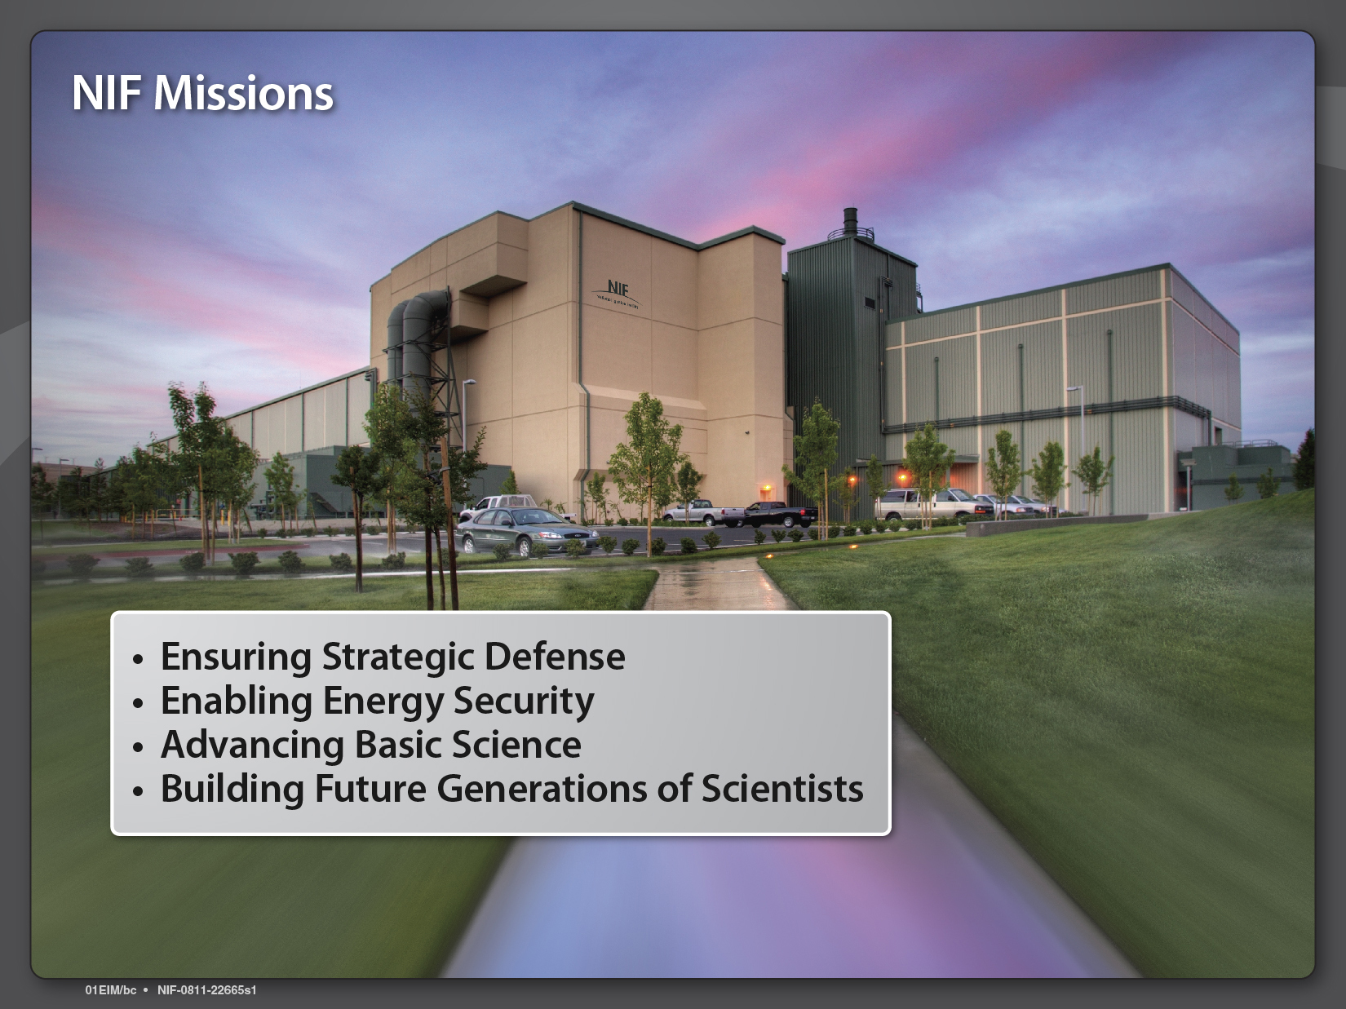
NIF Missions

Slide 4
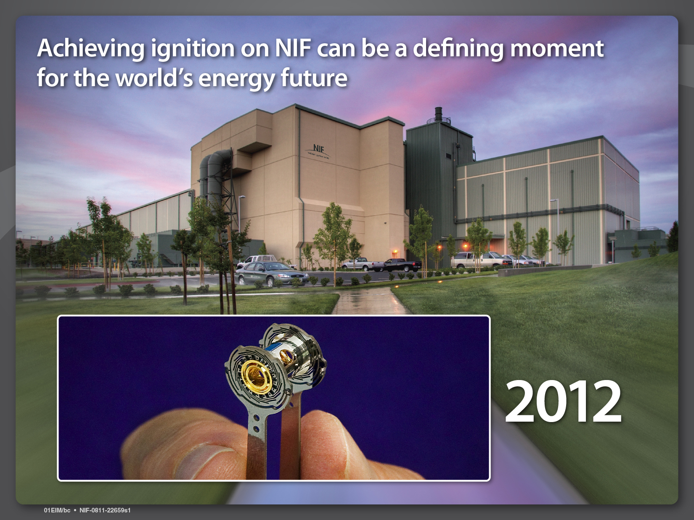
Achieving ignition on NIF can be a defining moment for the world’s energy future

Slide 5
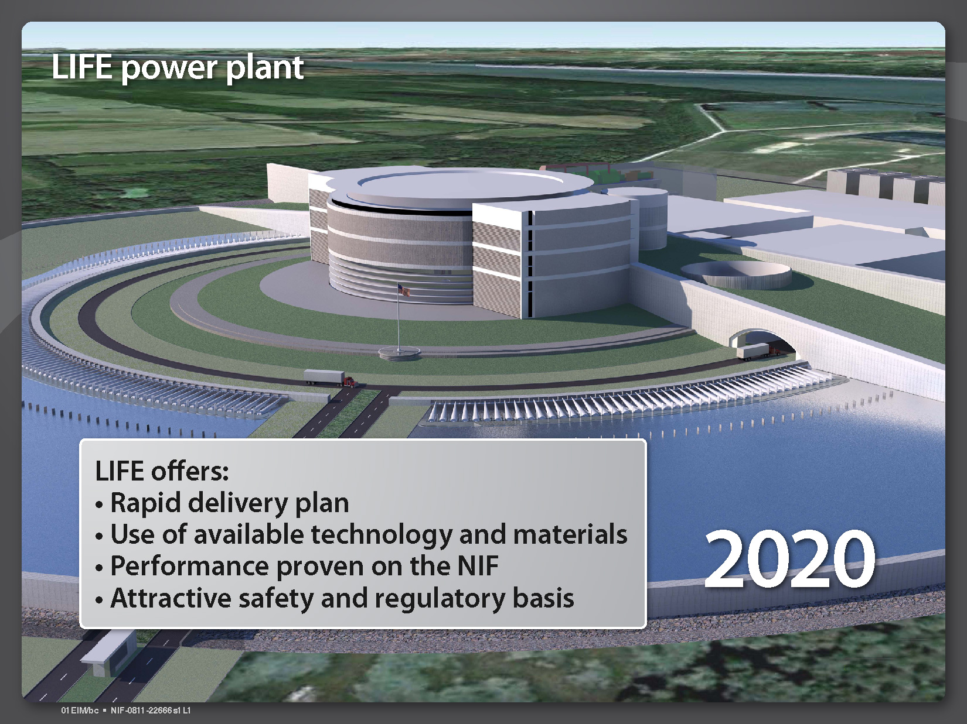
LIFE power plant

Slide 6
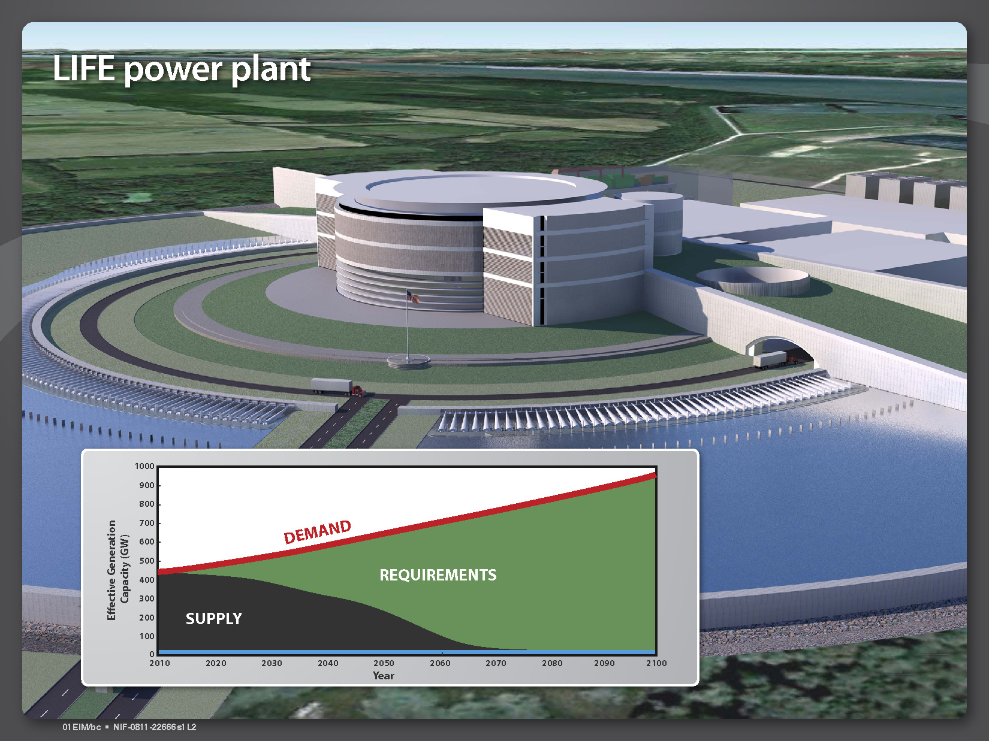
LIFE power plant

Slide 7

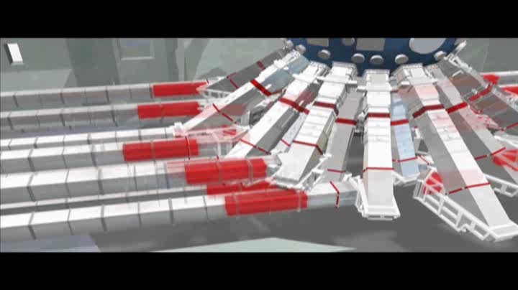
NIF Target Chamber
7
Notes:
MOVIE of NIF operations

Slide 8
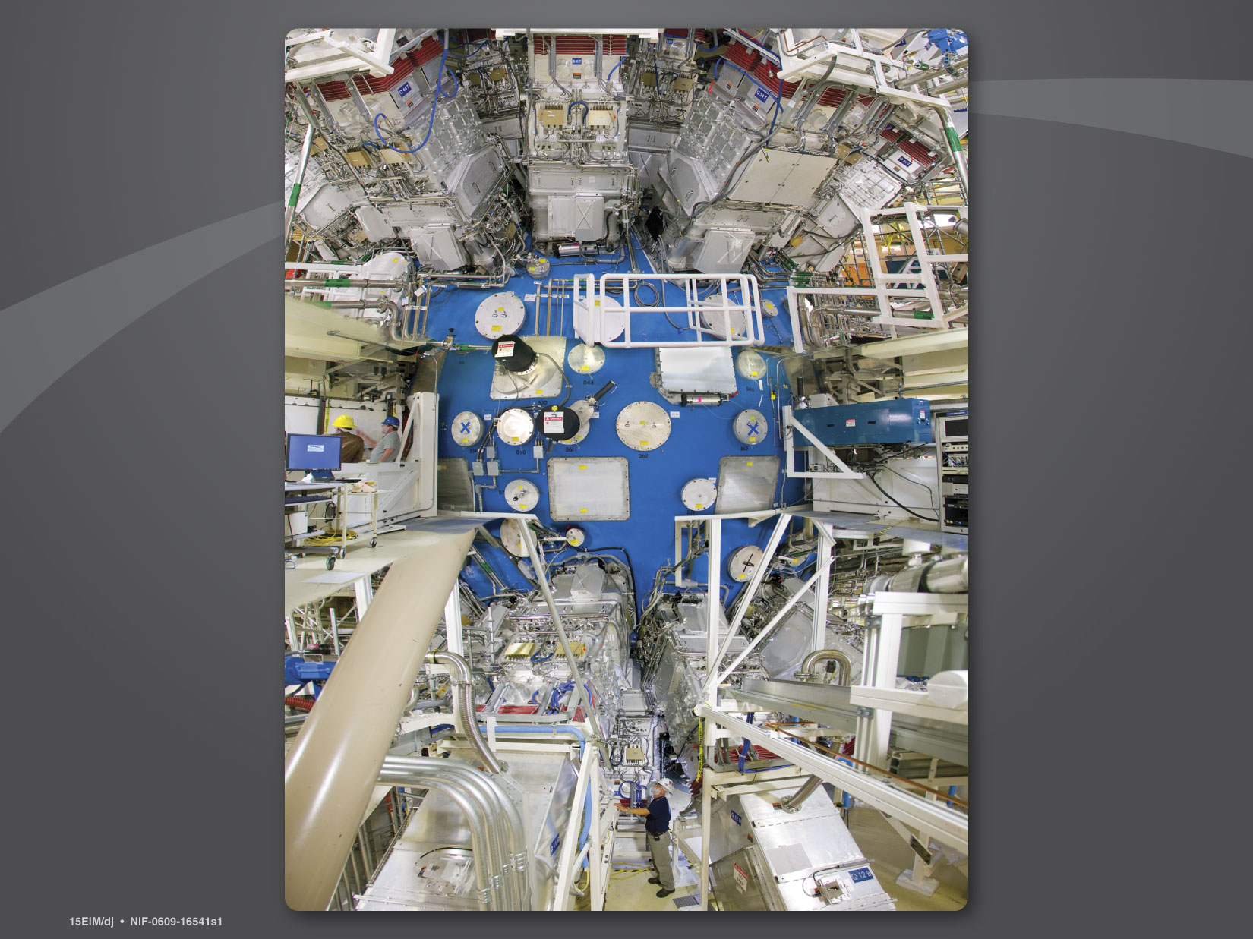
Full bleed of photoshopped version of the target chamber
NIF Target Chamber
Notes:
NIF was completed in 2009 and is now fully operational. Thank you to Congress for your continued support in providing the resources to build and now operate the NIF through DOE's NNSA. The same laws of physics we apply for national security are equal to those required for providing fusion energy. The United States is the clear world leader in this field. Others such as China and Europe are trailing today, but have dedicated programs in this area. NIF can provide full-scale performance data for a gigawatt power plant. Using this as the basis, we have put together an integrated design for a power plant known as LIFE. LIFE simply stands for Laser Inertial Fusion Energy.
This has been developed in close collaboration with utilities, industry, our supply chain, and technology partners from across the US.

Slide 9
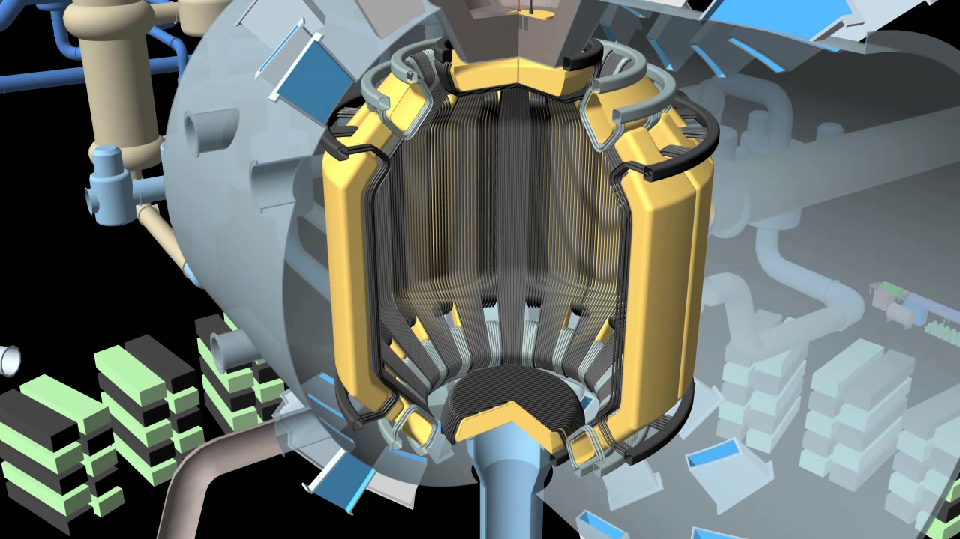
LIFE Target Chamber

Slide 10
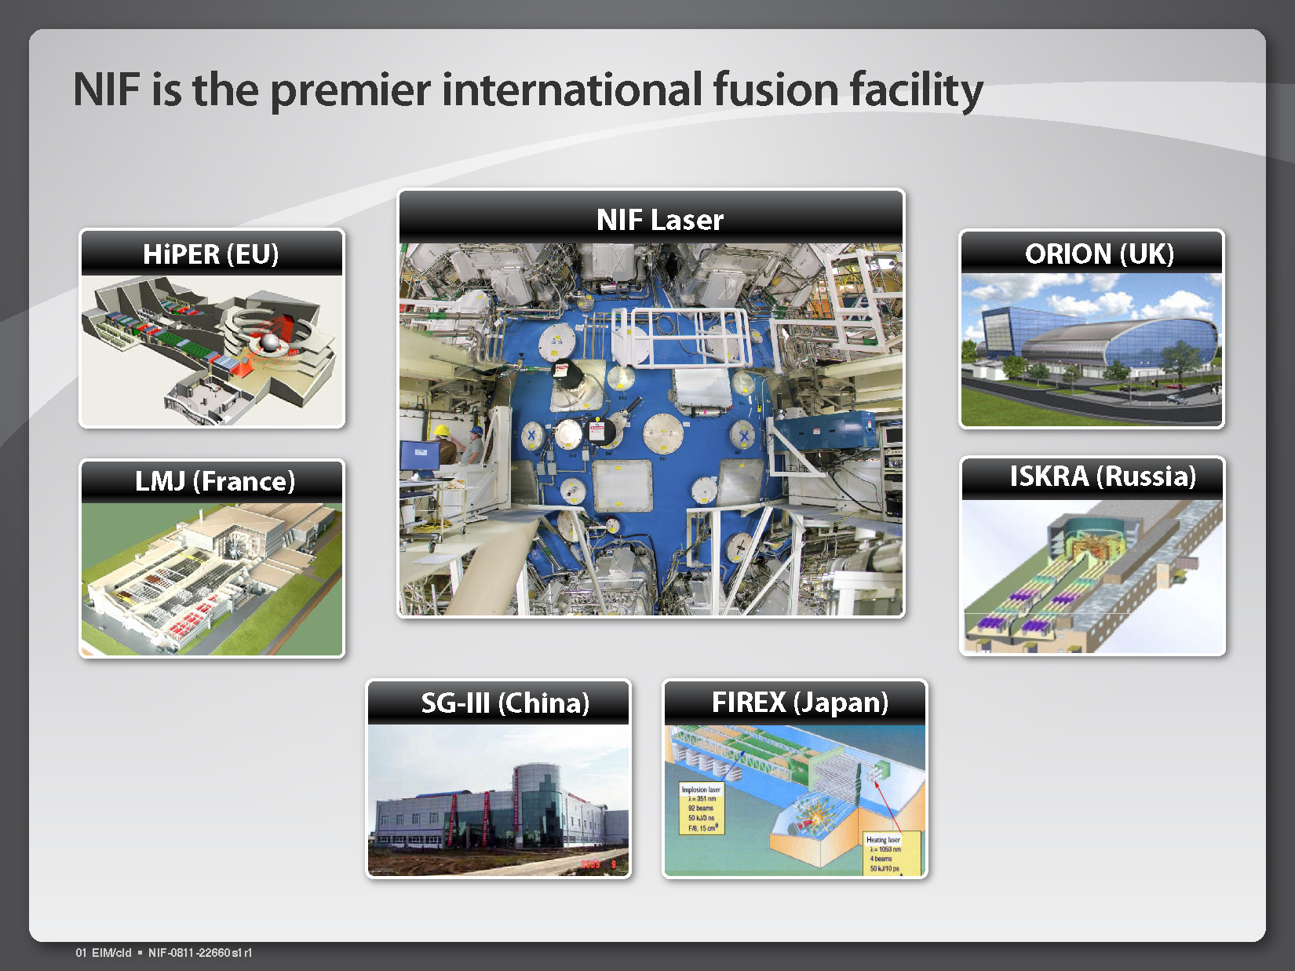
NIF, the premier facility of a growing international community

Slide 11
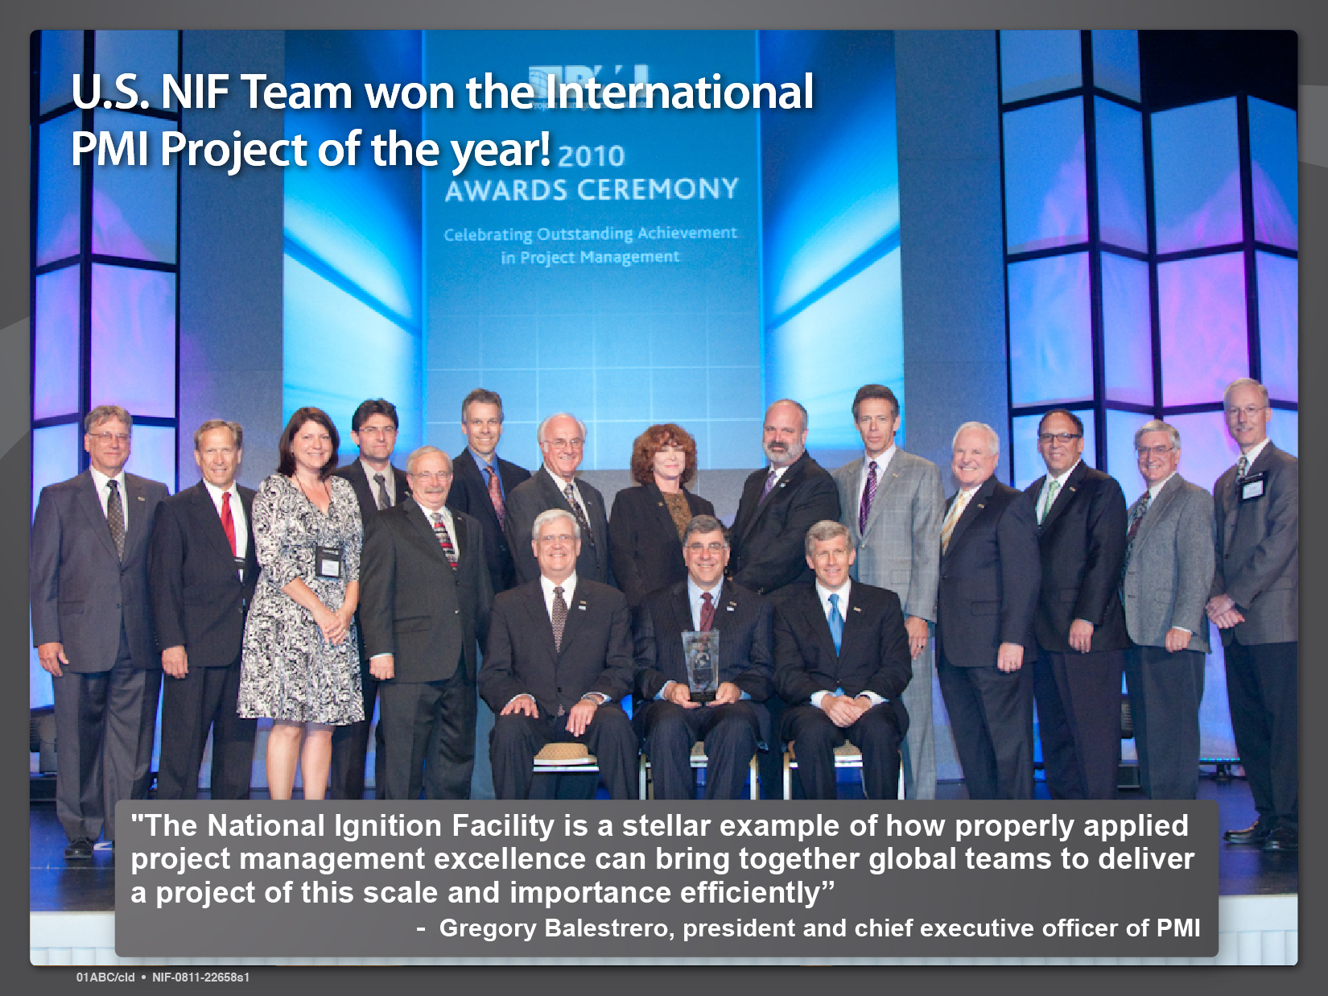
U.S. NIF Team won PMI Project of the year!

Slide 12
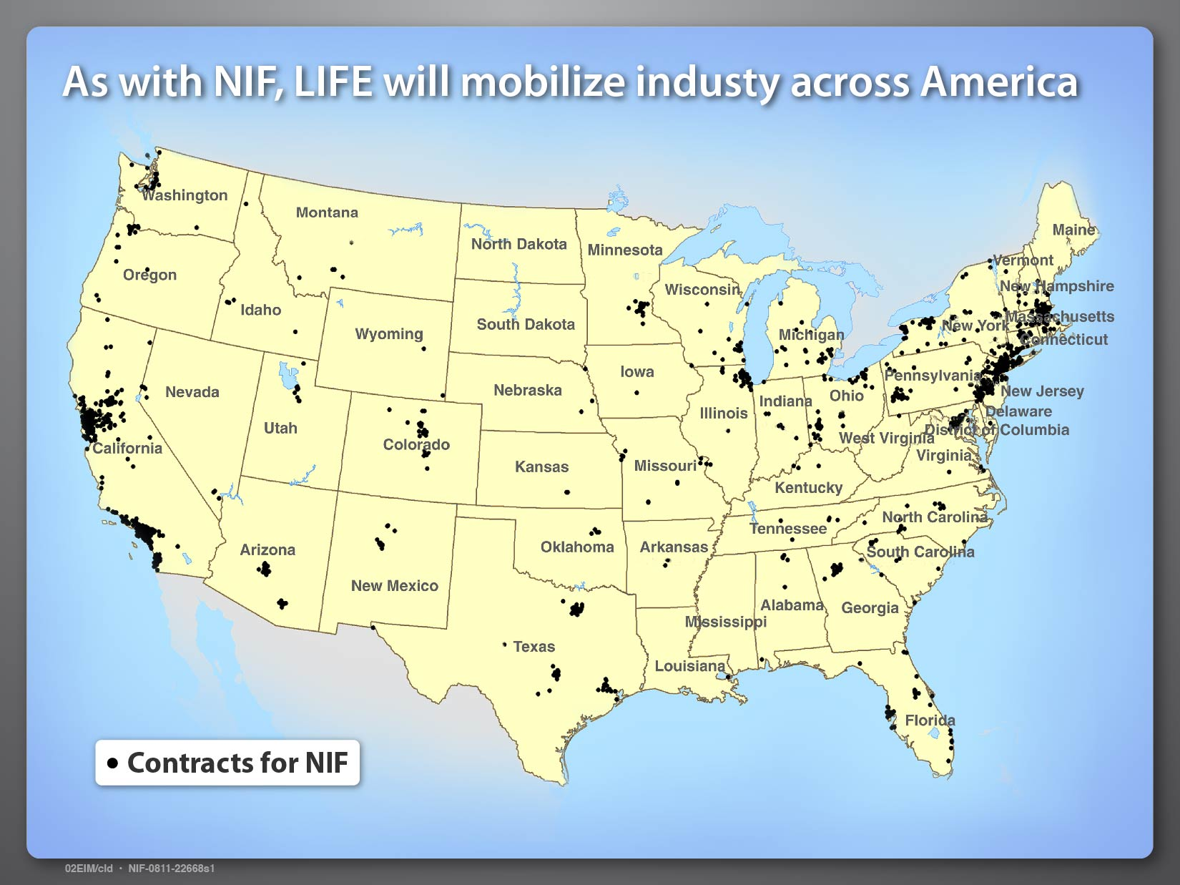
Notes:
NIF involved many thousands of vendors from across the US – 47 states.

Slide 13
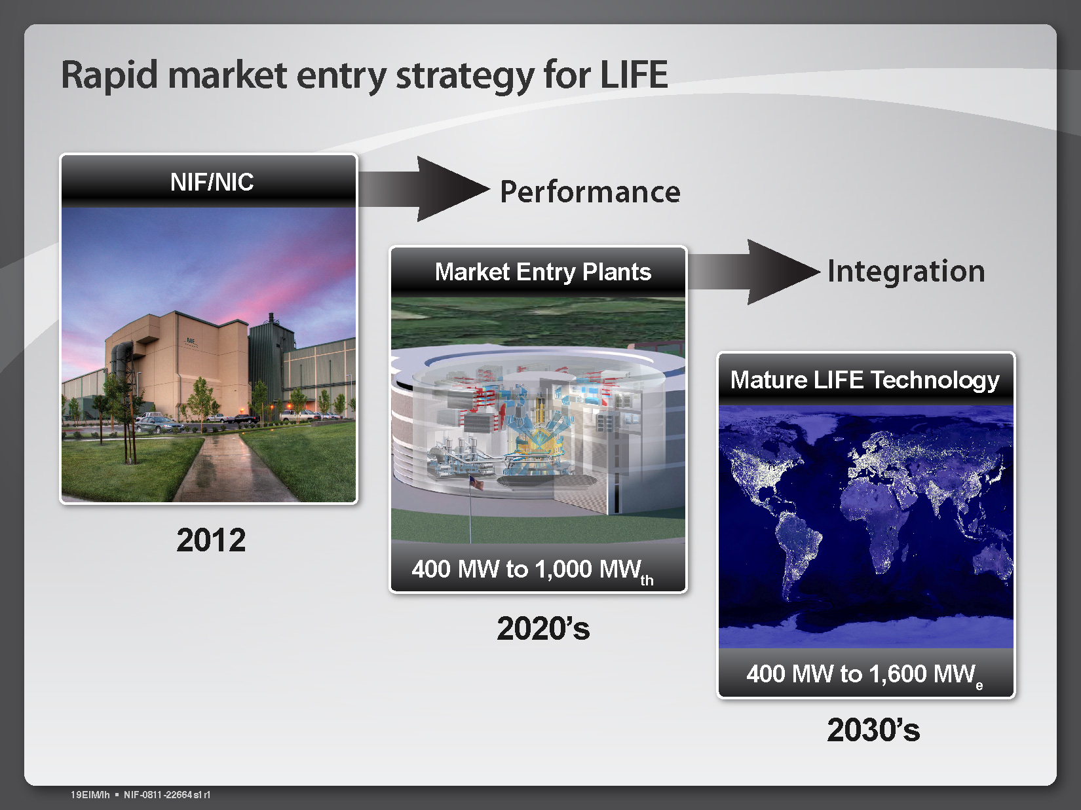
Rapid market entry strategy for LIFE

Slide 14
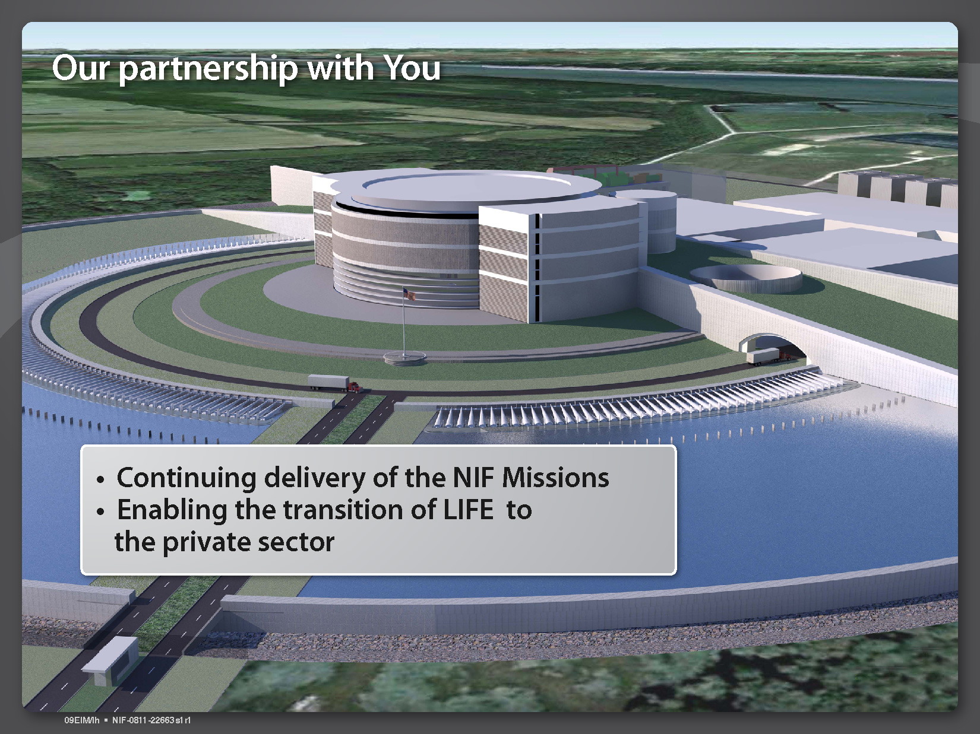
Our partnership with you

Slide 15
Achieving ignition on NIF can be a defining moment for the world’s energy future

