Slide 1
The path to magnetic fusion energy from physics to energy
Stewart Prager
Princeton Plasma Physics Laboratory

Slide 2
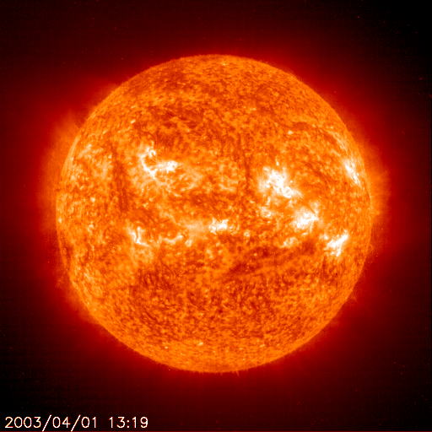
The Sun is a natural fusion reactor
A hot gas of billions of particles – a PLASMA
Particles undergo nuclear fusion reactions

Slide 3
The Sun is a natural fusion reactor
Temperature in sun
10 million degrees
Fusion reactor
100 million degrees
Surrounded by material
A hot gas of billions of particles – a PLASMA
Particles undergo nuclear fusion reactions

Slide 4
Goal: develop fusion as an energy source
“create a star on Earth”

Slide 5
Goal: develop fusion as an energy source
“create a star on Earth”
This won’t work – gravity is too weak

Slide 6
It required the development of the new field of plasma physics
Fusion energy is one of the most difficult science and engineering challenges ever undertaken
Accompanied by the development of
fusion engineering

Slide 7
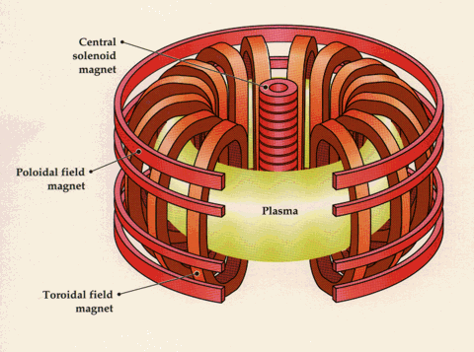
Solution: confine plasma in magnetic cage
magnets

Slide 8
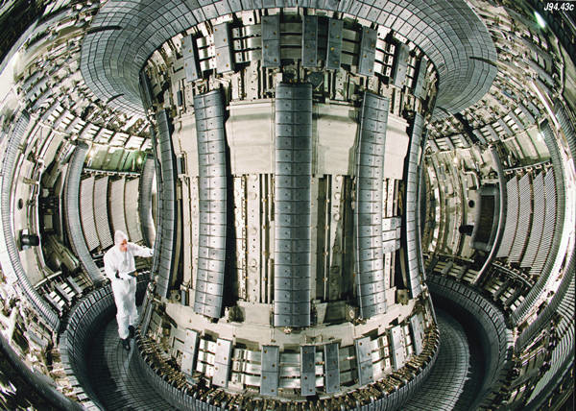
The largest tokamak (Jet,England)

Slide 9
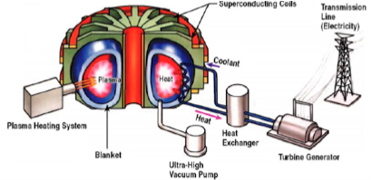
A fusion power plant
not to scale

Slide 10
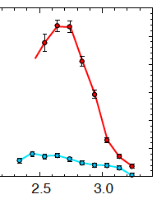
We have come very far…
Routinely producing plasmas at astronomical temperatures:
300 million degrees
330
Temperature
(million degrees)
0
radius (m)
And manipulating hot plasmas with remarkable finesses
(with radio waves, particle beams, magnetic fields…..)

Slide 11
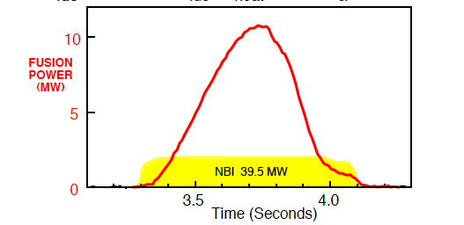
We have produced fusion energy
10 MW in 1994
PPPL
1997: 16 MW produced in JET (UK)

Slide 12
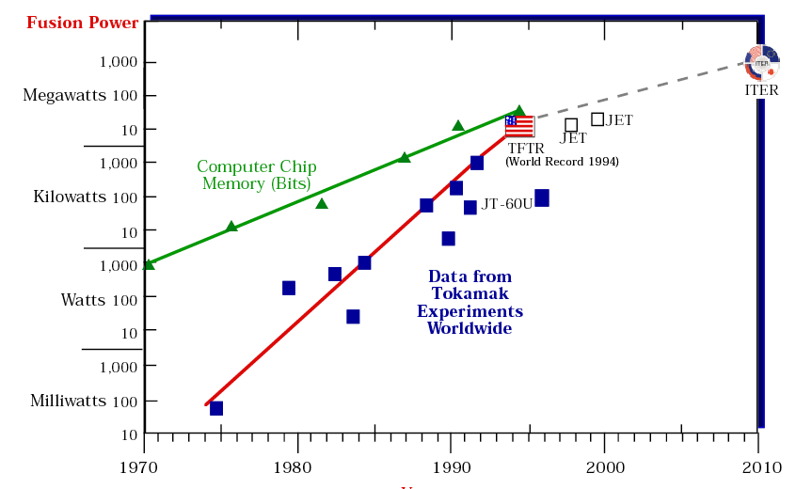
huge advance in fusion power
fusion power
year
Progress in fusion power halted by lack of facility, not science

Slide 13
These results in the early 1990s
triggered an increase in the worldwide fusion effort
(outside the US)

Slide 14
The international ITER experiment
Will generate 500 MW of fusion power for 500 seconds,
Study key physics and technology for fusion
Partnership covers half the world’s population
Under construction in France
the European Union (45%)
China
India
Japan
Russia
South Korea
The United States

Slide 15
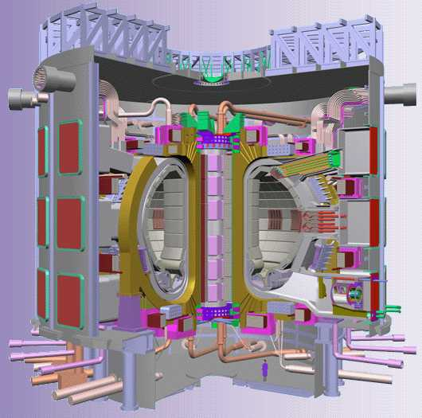
ITER is a reactor-scale experiment

Slide 16
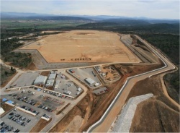
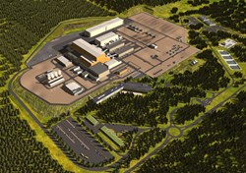
site preparation in France
Will operate in 2020

Slide 17
In addition to ITER, fusion research in other nations is surging

Slide 18
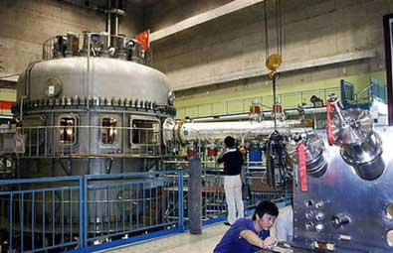
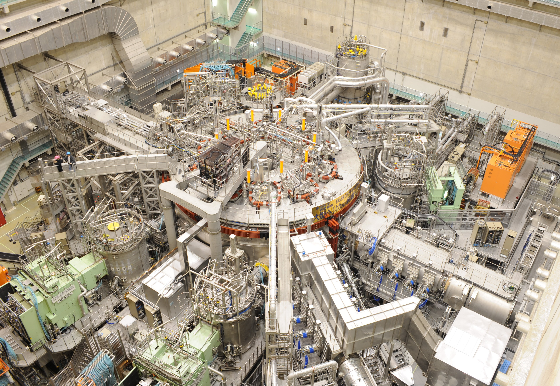
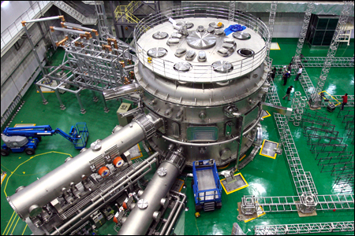
The escalating magnetic fusion activity across the world
China: superconducting tokamak
New major facilities
Japan: superconducting stellarator
Korea: superconducting tokamak

Slide 19
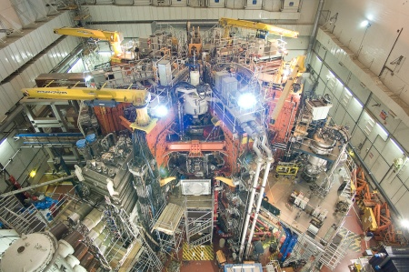
The escalating magnetic fusion activity across the world
England: tokamak
China: superconducting tokamak
Japan: superconducting stellarator
Korea: superconducting tokamak

Slide 20
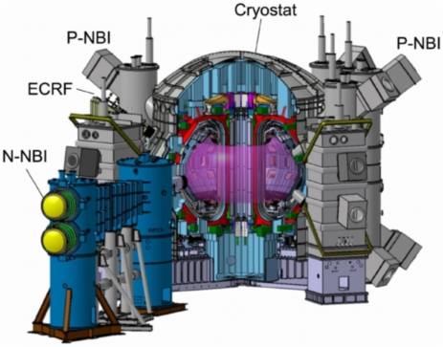
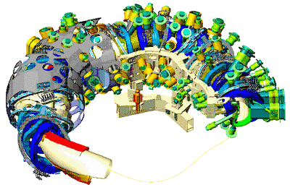
Major facilities under construction
Japan: superconducting tokamak
Germany: superconducting stellarator
France: ITER
The world has entered the era of superconducting facilities (steady-state)

Slide 21
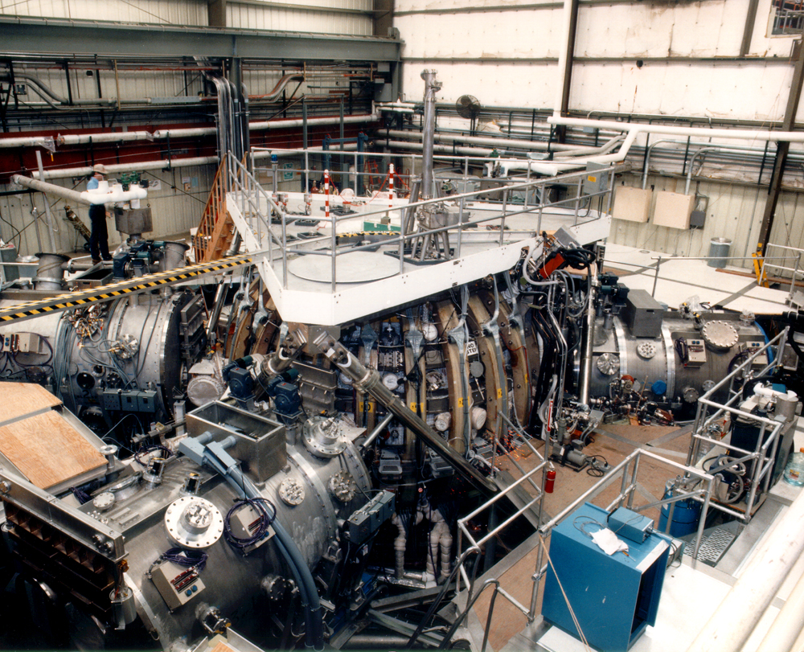
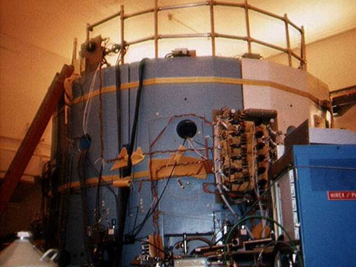
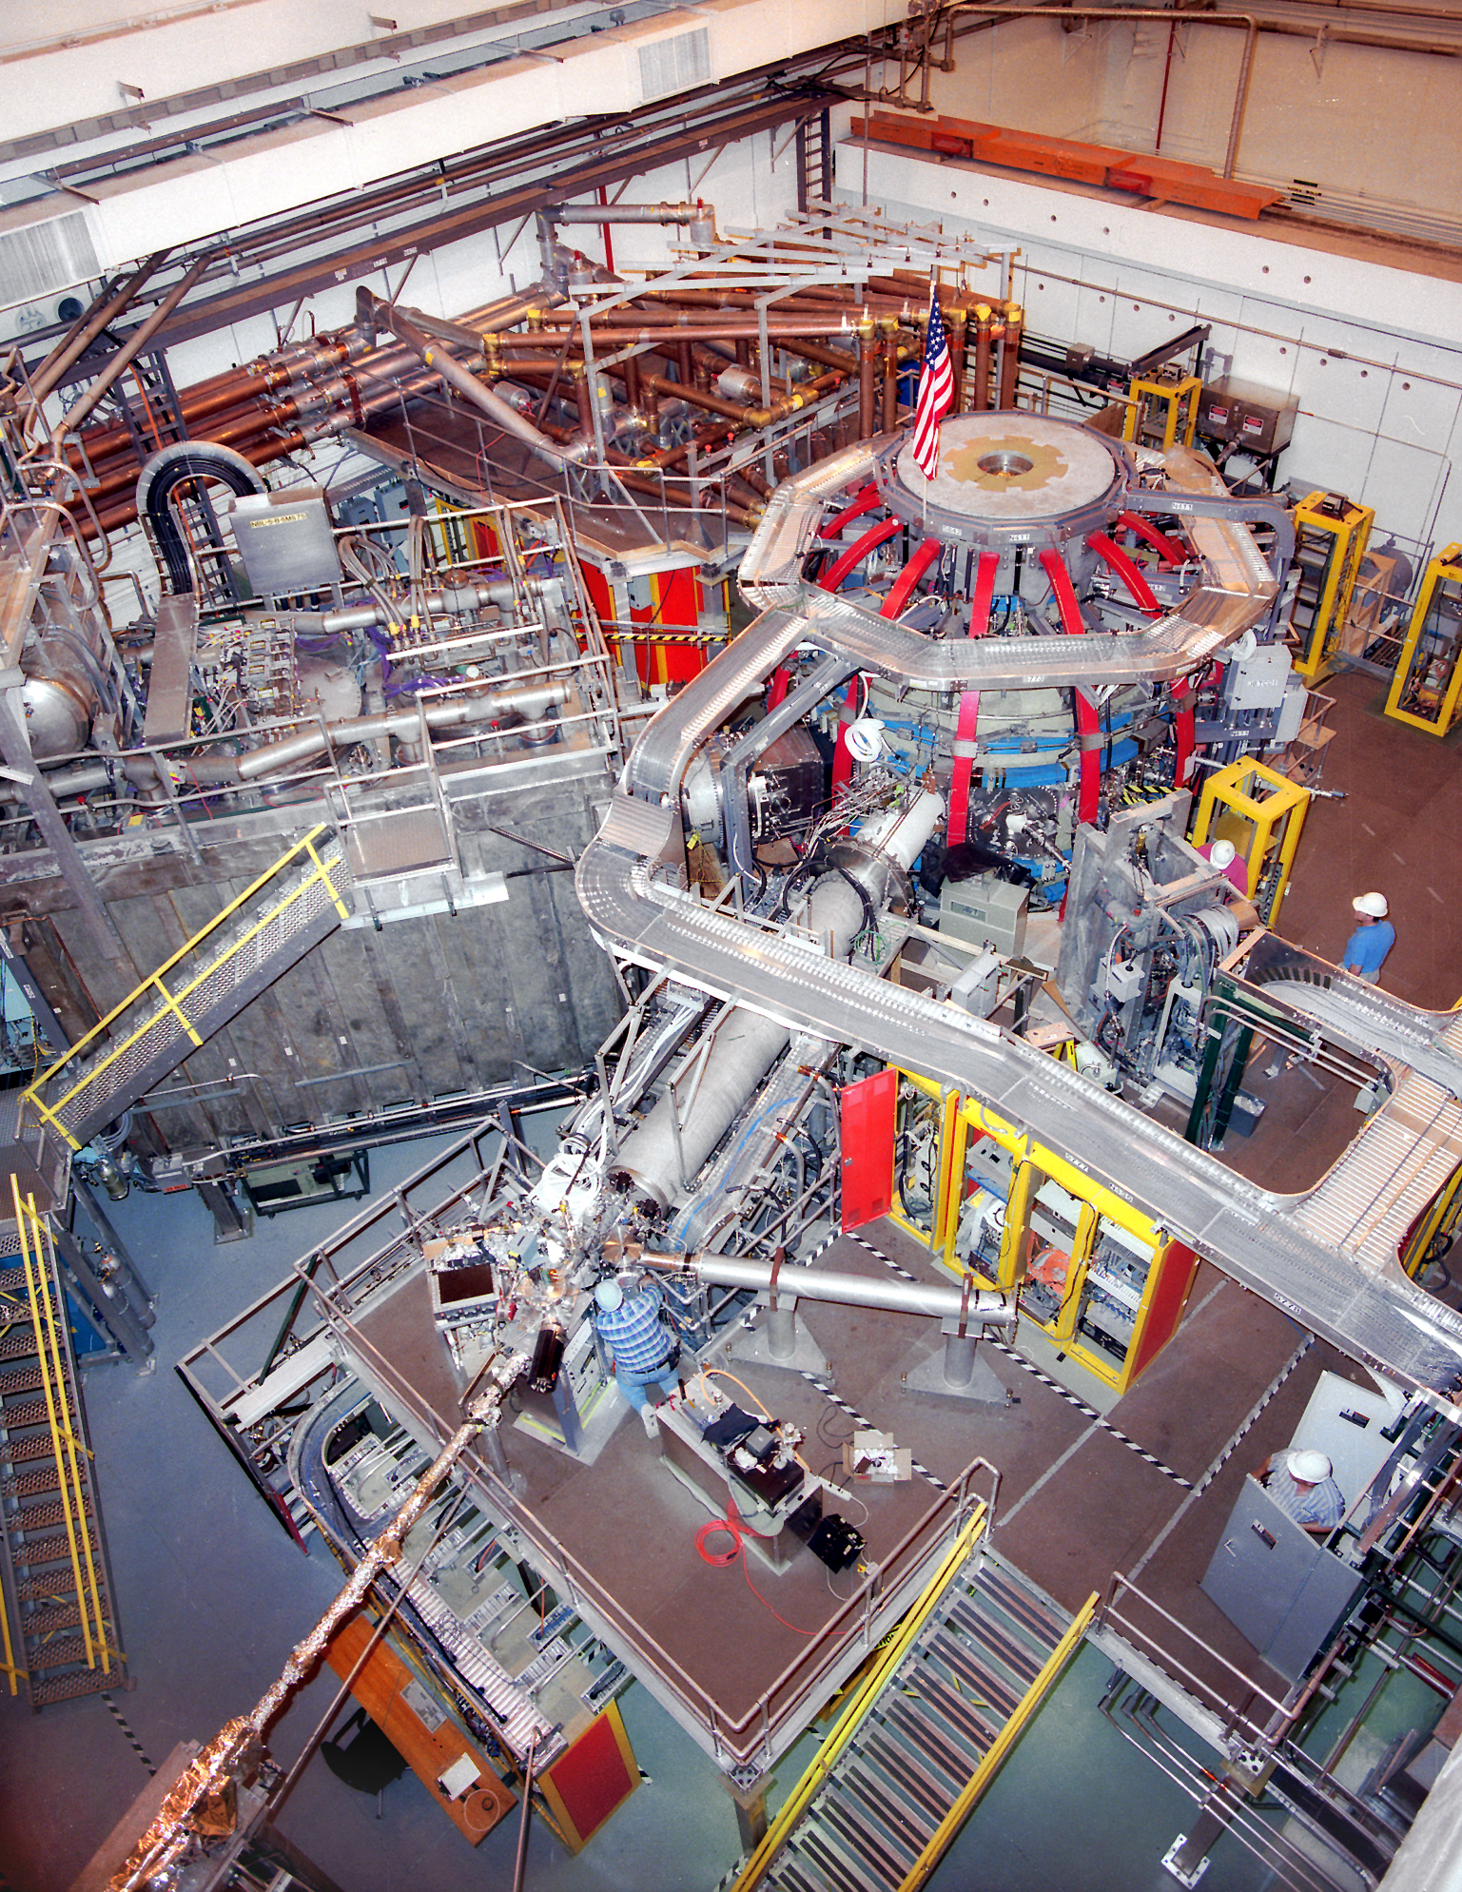
The US operates a strong set of medium-scale experiments
General Atomics MIT Princeton (PPPL)
Performing world-leading fusion research
for ITER and beyond
However, in 10 years, the new facilities overseas will be more
capable than the US facilities
Ready to move to new facilities to attack remaining issues for fusion

Slide 22
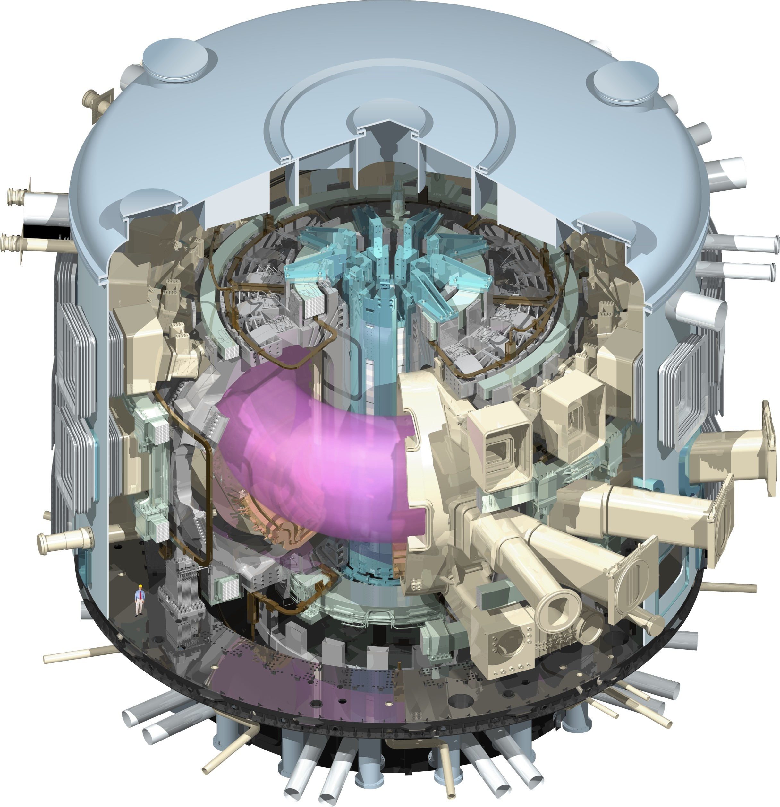
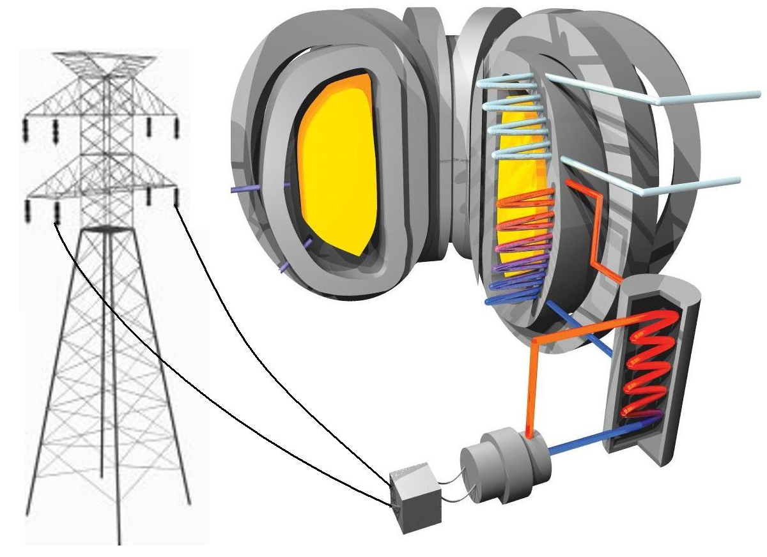
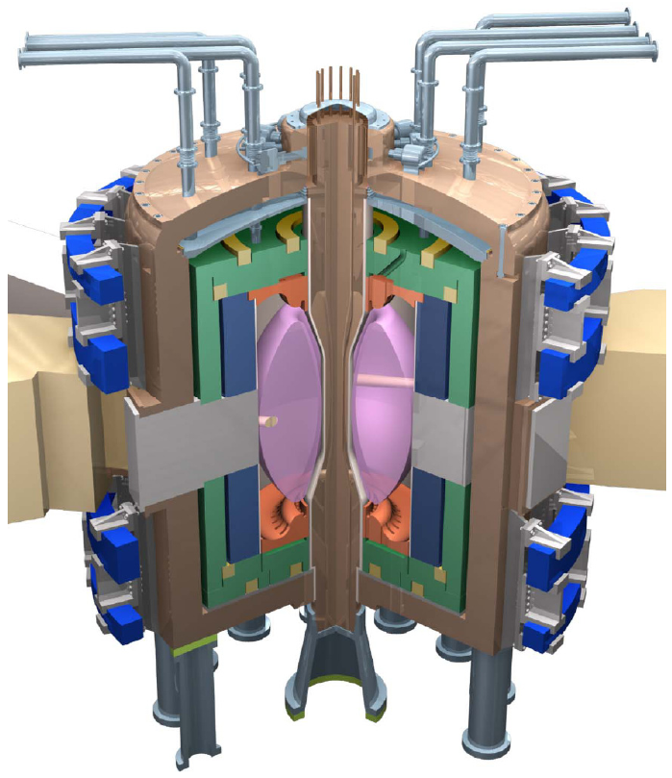
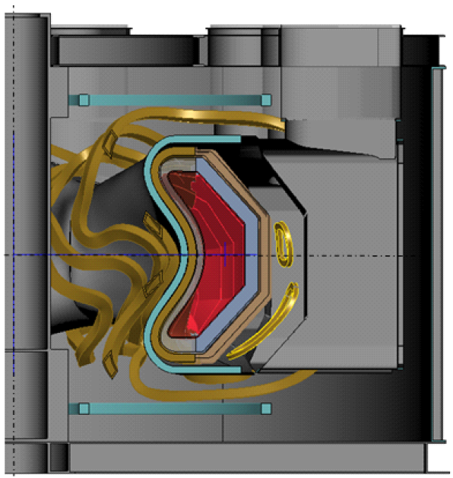
A US roadmap to fusion energy
~ 2020 start
ITER
Demonstration
Power Plant
Supporting Research Program
Plasma confinement
Materials science/engineering
US Fusion
Nuclear
Facility
~ 2035 start
~ 2025 start

Slide 23
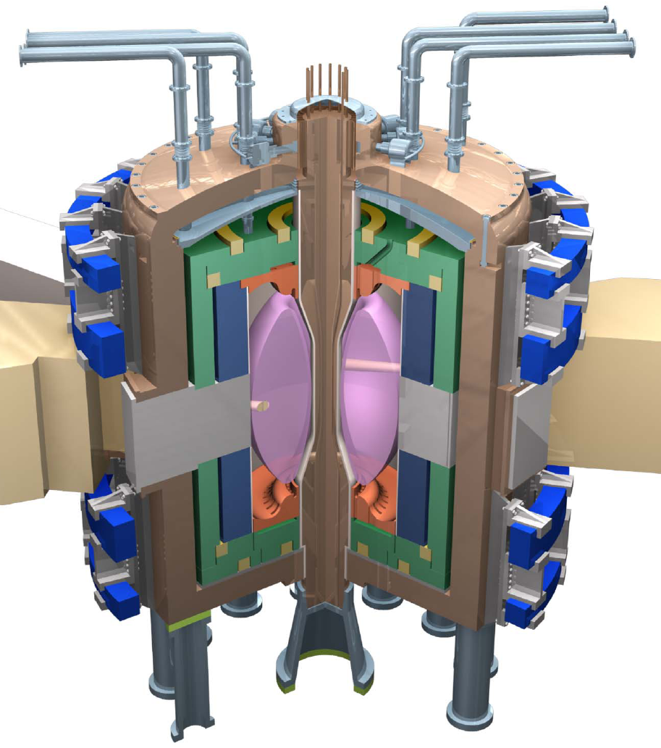
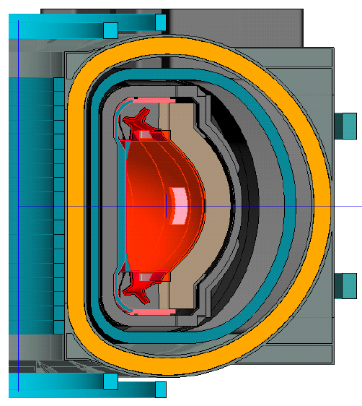
US Fusion Nuclear Facility
Integrates key features of power plant in continuous operation, but at a scale less than that of a power plant
several options under study, from
Material tests in
fusion environment
Facility that also generates net electricity (pilot plant)
to

Slide 24
Current program
~ 2020 start
ITER
Demonstration
Power Plant
Supporting Research Program
Plasma confinement
Materials science/engineering
US Fusion
Nuclear
Facility
~ 2035 start
~ 2025 start

Slide 25
Full, aggressive program
~ 2020 start
ITER
(full)
Demonstration
Power Plant
Supporting Research Program
Plasma confinement
Materials science/engineering
US Fusion
Nuclear
Facility
~ 2035 start
~ 2025 start

Slide 26
To conclude,
Scientists are confident we can make fusion power for large-scale energy use
Research challenges remain that will determine economic attractiveness
If there is societal will, we can have a clean, safe, abundant, domestic fusion energy source in our lifetime
Rough annual cost: 0.1% of annual US energy expenditure
(about $1.5B out of $1.5 T)

